Slide 1
Lecture 01 – Part C
Constraint Satisfaction Problems
Dr. Shazzad Hosain
Department of EECS
North South University
shazzad@northsouth.edu

Slide 2
Constraint Satisfaction Problems (CSPs)
Standard search problem:
  state is a "black box“ – any data structure that supports successor function, heuristic function, and goal test
CSP:
  state is defined by variables X_{i} with values from domain D_{i}
  goal test is a set of constraints specifying allowable combinations of values for subsets of variables

Slide 3
Constraint satisfaction problem
A CSP is defined by
  a set of variables
  a domain of possible values for each variable
  a set of constraints between variables
An assignment that does not violate any constraints is called a consistent or legal CONSISTENT assignment.
A complete assignment is one in which every variable is mentioned.
A solution to a CSP is
  A complete assignment that satisfies all the constraints

Slide 4

Example: Map-Coloring
Variables WA, NT, Q, NSW, V, SA, T
Domains D_{i} = {red, green, blue}
Constraints: adjacent regions must have different colors
  e.g., WA ≠ NT

Slide 5

Example: Map-Coloring
Solutions are complete and consistent assignments, e.g.,
  WA = red, NT = green, Q = red, NSW = green, V = red, SA = blue, T = green
A state may be incomplete e.g., just WA=red

Slide 6
Constraint graph
It is helpful to visualize a CSP as a constraint graph
  Binary CSP: each constraint relates two variables
  Constraint graph: nodes are variables, arcs are constraints
NT
Q
WA
NSW
SA
V
T
Notes:
Here each link relates two nodes i.e. variables
Binary constraints involve pairs of variables e.g. SA ≠ WA

Slide 7
Varieties of CSPs
Discrete variables
  finite domains:
    n variables, domain size d → O(d^{n}) complete assignments
    e.g., Boolean CSPs, incl. Boolean satisfiability (NP-complete)
  infinite domains:
    integers, strings, etc.
    e.g., job scheduling, variables are start/end days for each job
    need a constraint language, e.g., StartJob₁ + 5 ≤ StartJob₃
Continuous variables
  e.g., start/end times for Hubble Space Telescope observations
  linear constraints solvable in polynomial time by linear programming

Slide 8
Varieties of constraints
Unary constraints involve a single variable,
  e.g., SA ≠ green
Binary constraints involve pairs of variables,
  e.g., SA ≠ WA
Higher-order constraints involve 3 or more variables,
  e.g., cryptarithmetic column constraints

Slide 9
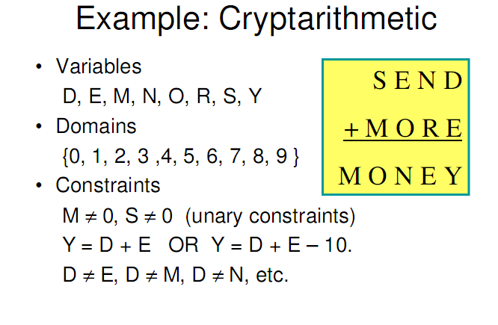
Notes:
Y = D + E, involves more than two variables.

Slide 10
Constraint Satisfaction problem
Backtracking Search

Slide 11

Standard search formulation
Let’s try the standard search formulation.
We need:
Initial state: none of the variables has a value (color)
Successor state: one of the variables without a value will get some value.
Goal: all variables have a value and none of the constraints is violated.
NxD
N layers
WA
WA
WA
NT
T
[NxD]x[(N-1)xD]
WA
NT
WA
NT
WA
NT
NT
WA
N! x D^{N}
Equal!
There are N! x D^{N} nodes in the tree but only D^{N} distinct states??

Slide 12
Backtracking search
Every solution appears at depth n with n variables
→ use depth-first search
Depth-first search for CSPs with single-variable assignments is called backtracking search
Backtracking search is the basic uninformed algorithm for CSPs
Can solve n-queens for n ≈ 25

Slide 13
Backtracking (Depth-First) search
Special property of CSPs: They are commutative:
This means: the order in which we assign variables
does not matter.
Better search tree: First order variables, then assign them values one-by-one.
NT
WA
=
WA
NT
D
WA
WA
WA
WA
NT
D²
WA
NT
WA
NT
D^{N}

Slide 14

Backtracking search

Slide 15

Backtracking example

Slide 16

Backtracking example

Slide 17

Backtracking example

Slide 18

Backtracking example

Slide 19
Depth First Search (DFS)
Application:
Given the following state space (tree search), give the sequence of visited nodes when using DFS (assume that the nodeO is the goal state):
A
B
C
D
E
F
G
H
I
J
K
L
M
N
O

Slide 20
Depth First Search
A,
A
B
C
D
E

Slide 21
Depth First Search
A,B,
A
B
C
D
E
F
G

Slide 22
Depth First Search
A,B,F,
A
B
C
D
E
F
G

Slide 23
Depth First Search
A,B,F,
G,
A
B
C
D
E
F
G
K
L

Slide 24
Depth First Search
A,B,F,
G,K,
A
B
C
D
E
F
G
K
L

Slide 25
Depth First Search
A,B,F,
G,K,
L,
A
B
C
D
E
F
G
K
L
O

Slide 26
Depth First Search
A,B,F,
G,K,
L, O: Goal State
A
B
C
D
E
F
G
K
L
O

Slide 27
Depth First Search
The returned solution is the sequence of operators in the path: A, B, G, L, O : assignments when using CSP !!!
A
B
C
D
E
F
G
K
L
O

Slide 28
Backtracking
Example 1

Slide 29
Example of a csp
A
B
E
C
D
H
F
G
3 colour me!

Slide 30
Example of a csp
{blue, green, red}
{blue, green, red}
A
B
{blue, green, red}
E
C
{blue, green, red}
D
{blue, green, red}
H
{blue, green, red}
F
G
{blue, green, red}
{blue, green, red}
3 colour me!

Slide 31
Example of a csp
A
B
E
C
D
H
F
G
1 = red
2 = blue
3 = green

Slide 32
Example of a csp
A
B
E
C
D
H
F
G
1 = red
2 = blue
3 = green

Slide 33
Example of a csp
A
B
E
C
D
H
F
G
1 = red
2 = blue
3 = green

Slide 34
Example of a csp
A
B
E
C
D
H
F
G
1 = red
2 = blue
3 = green

Slide 35
Example of a csp
A
B
E
C
D
H
F
G
1 = red
2 = blue
3 = green

Slide 36
Example of a csp
A
B
E
C
D
H
F
G
1 = red
2 = blue
3 = green

Slide 37
Example of a csp
A
B
E
C
D
H
F
G
Dead end → backtrack
1 = red
2 = blue
3 = green

Slide 38
Example of a csp
A
B
E
C
D
H
F
G
1 = red
2 = blue
3 = green

Slide 39
Example of a csp
A
B
E
C
D
H
F
G
1 = red
2 = blue
3 = green

Slide 40
Example of a csp
A
B
E
C
D
H
F
G
1 = red
2 = blue
3 = green

Slide 41
Example of a csp
A
B
E
C
D
H
F
G
1 = red
2 = blue
3 = green

Slide 42
Example of a csp
A
B
E
C
D
H
F
G
1 = red
2 = blue
3 = green

Slide 43
Example of a csp
A
B
E
C
D
H
Solution !!!!
F
G
1 = red
2 = blue
3 = green

Slide 44
Backpropagation
Example 2

Slide 45
Backpropagation
[R,B,G]
[R,B,G]
[R]
[R,B,G]
[R,B,G]

Slide 46
Backpropagation
[R,B,G]
[R,B,G]
[R]
[R,B,G]
[R,B,G]

Slide 47
Backpropagation
[R,B,G]
[R,B,G]
[R]
[R,B,G]
[R,B,G]

Slide 48
Backpropagation
[R,B,G]
[R,B,G]
[R]
[R,B,G]
[R,B,G]

Slide 49
Backpropagation
[R,B,G]
[R,B,G]
[R]
[R,B,G]
[R,B,G]

Slide 50
Backpropagation
[R,B,G]
[R,B,G]
[R]
[R,B,G]
[R,B,G]
Dead End → Backtrack

Slide 51
Backpropagation
[R,B,G]
[R,B,G]
[R]
[R,B,G]
[R,B,G]

Slide 52
Backpropagation
[R,B,G]
[R,B,G]
[R]
[R,B,G]
[R,B,G]

Slide 53
Backpropagation
[R,B,G]
[R,B,G]
[R]
[R,B,G]
[R,B,G]
Solution !!!

Slide 54
Improving backtracking efficiency

Slide 55
Improving backtracking efficiency
General-purpose heuristics can give huge gains in speed:
  Which variable should be assigned next?
  In what order should its values be tried?
  Can we detect inevitable failure early?

Slide 56

Most constrained variable
Minimum Remaining Values (MRV)
Most constrained variable:
  choose the variable with the fewest legal values
Called minimum remaining values (MRV) heuristic
“fail-first” heuristic: Picks a variable which will cause failure as soon as possible, allowing the tree to be pruned.

Slide 57
Backpropagation
Minimum Remaining Values (MRV)
choose the variable with the fewest legal values

Slide 58
Backpropagation - MRV
[R,B,G]
[R,B,G]
[R]
[R,B,G]
[R,B,G]

Slide 59
Backpropagation - MRV
[R,B,G]
[R,B,G]
[R]
[R,B,G]
[R,B,G]

Slide 60
Backpropagation - MRV
[R,B,G]
[R,B,G]
[R]
[R,B,G]
[R,B,G]

Slide 61
Backpropagation - MRV
[R,B,G]
[R,B,G]
[R]
[R,B,G]
[R,B,G]
choose the variable with the fewest legal values

Slide 62
Backpropagation - MRV
[R,B,G]
[R,B,G]
[R]
[R,B,G]
[R,B,G]
choose the variable with the fewest legal values

Slide 63
Backpropagation - MRV
[R,B,G]
[R,B,G]
[R]
[R,B,G]
[R,B,G]
Solution !!!

Slide 64

Degree Heuristic or
Most Constraint Variable (MCV)
MRV doesn’t help in
choosing the first region to color
Most constraining variable:
  choose the variable with the most constraints
  on remaining variables (select variable that is involved in
  the largest number of constraints - edges in graph
  on other unassigned variables)
MRV heuristic is usually more powerful, but MCV
can be useful as tie-breaker

Slide 65

Least constraining value (LCV)
Given a variable, choose the
least constraining value:
  the one that rules out (eliminate)
  the fewest values in the
  remaining variables
Combining these heuristics makes 1000 queens feasible

Slide 66
Constraint Satisfaction problem
Backtracking + Forward Checking

Slide 67
Forward Checking
Assigns variable X, say
Looks at each unassigned variable, Y say, connected to X and delete from Y’s domain any value inconsistent with X’s assignment
Eliminates branching on certain variables by propagating information
If forward checking detects a dead end, algorithm will backtrack immediately.

Slide 68

Forward checking
Idea:
  Keep track of remaining legal values for unassigned variables
  Terminate search when any variable has no legal values

Slide 69

Forward checking
Idea:
  Keep track of remaining legal values for unassigned variables
  Terminate search when any variable has no legal values

Slide 70

Forward checking
Idea:
  Keep track of remaining legal values for unassigned variables
  Terminate search when any variable has no legal values

Slide 71

Forward checking
Idea:
  Keep track of remaining legal values for unassigned variables
  Terminate search when any variable has no legal values
Dead End

Slide 72
Forward Checking
Examples

Slide 73
Example: 4-Queens Problem
X1
{1,2,3,4}
X2
{1,2,3,4}
1
2
3
4
1
2
3
4
X3
{1,2,3,4}
X4
{1,2,3,4}
[4-Queens slides copied from B.J. Dorr CMSC 421 course on AI]

Slide 74
Example: 4-Queens Problem
X1
{1,2,3,4}
X2
{1,2,3,4}
1
2
3
4
1
2
3
4
X3
{1,2,3,4}
X4
{1,2,3,4}

Slide 75
Example: 4-Queens Problem
X1
{1,2,3,4}
X2
{ , ,3,4}
1
2
3
4
1
2
3
4
X3
{ ,2, ,4}
X4
{ ,2,3, }

Slide 76
Example: 4-Queens Problem
X1
{1,2,3,4}
X2
{ , ,3,4}
1
2
3
4
1
2
3
4
X3
{ ,2, ,4}
X4
{ ,2,3, }

Slide 77
Example: 4-Queens Problem
X1
{1,2,3,4}
X2
{ , ,3,4}
1
2
3
4
1
2
3
4
X3
{ , , , }
X4
{ ,2, , }
Dead End → Backtrack

Slide 78
Example: 4-Queens Problem
X1
{1,2,3,4}
X2
{ , , ,4}
1
2
3
4
1
2
3
4
X3
{ , 2 , , }
X4
{ , ,3, }

Slide 79
Example: 4-Queens Problem
X1
{1,2,3,4}
X2
{ , , ,4}
1
2
3
4
1
2
3
4
X3
{ , 2 , , }
X4
{ , , , }
Dead End → Backtrack

Slide 80
Example: 4-Queens Problem
X1
{ ,2,3,4}
X2
{1,2,3,4}
1
2
3
4
1
2
3
4
X3
{1,2,3,4}
X4
{1,2,3,4}

Slide 81
Example: 4-Queens Problem
X1
{ ,2,3,4}
X2
{ , , ,4}
1
2
3
4
1
2
3
4
X3
{1, ,3, }
X4
{1, ,3,4}

Slide 82
Example: 4-Queens Problem
X1
{ ,2,3,4}
X2
{ , , ,4}
1
2
3
4
1
2
3
4
X3
{1, ,3, }
X4
{1, ,3,4}

Slide 83
Example: 4-Queens Problem
X1
{ ,2,3,4}
X2
{ , , ,4}
1
2
3
4
1
2
3
4
X3
{1, , , }
X4
{1, ,3, }

Slide 84
Example: 4-Queens Problem
X1
{ ,2,3,4}
X2
{ , , ,4}
1
2
3
4
1
2
3
4
X3
{1, , , }
X4
{1, ,3, }

Slide 85
Example: 4-Queens Problem
X1
{ ,2,3,4}
X2
{ , , ,4}
1
2
3
4
1
2
3
4
X3
{1, , , }
X4
{ , ,3, }

Slide 86
Example: 4-Queens Problem
X1
{ ,2,3,4}
X2
{ , , ,4}
1
2
3
4
1
2
3
4
X3
{1, , , }
X4
{ , ,3, }
Solution !!!!

Slide 87
Forward Checking
[R,B,G]
[R,B,G]
[R]
[R,B,G]
[R,B,G]

Slide 88
Forward Checking
[ ,B,G]
[R,B,G]
[R]
[ ,B,G]
[R,B,G]

Slide 89
Forward Checking
[ ,B,G]
[R,B,G]
[R]
[ ,B,G]
[R,B,G]

Slide 90
Forward Checking
[ ,B,G]
[R, ,G]
[R]
[ , ,G]
[R, ,G]

Slide 91
Forward Checking
[ ,B,G]
[R, ,G]
[R]
[ , ,G]
[R, ,G]

Slide 92
Forward Checking
[ ,B,G]
[R, ,G]
[R]
[ , ,G]
[ , ,G]

Slide 93
Forward Checking
[ ,B,G]
[R, ,G]
[R]
[ , ,G]
[ , ,G]

Slide 94
Forward Checking
[ ,B,G]
[R, ,G]
[R]
[ , , ]
[ , ,G]

Slide 95
Forward Checking
[ ,B,G]
[R, ,G]
[R]
[ , , ]
[ , ,G]
Dead End

Slide 96
Forward Checking
[ ,B,G]
[R, ,G]
[R]
[ , ,G]
[R, ,G]

Slide 97
Forward Checking
[ ,B,G]
[R, ,G]
[R]
[ , ,G]
[R, , ]

Slide 98
Forward Checking
[ ,B,G]
[R, ,G]
[R]
[ , ,G]
[R, , ]

Slide 99
Forward Checking
[ ,B,G]
[R, ,G]
[R]
[ , ,G]
[R, , ]
Solution !!!

Slide 100
Constraint Satisfaction problem
Constraint Propagation
Backtracking + Arc Consistency

Slide 101
Constraint propagation
Forward checking propagates information from assigned to unassigned variables, but doesn't provide early detection for all failures:
NT and SA cannot both be blue!
Constraint propagation repeatedly enforces constraints locally

Slide 102
Arc consistency
More complex than forward checking,
but backtracks sooner so may be faster
Make each arc consistent
Constraints treated as directed arcs
X →Y is consistent iff
  for every value of X there is some allowed value for Y
Note:
  If the arc from A to B is consistent, the (reverse) arc from B to A is not necessarily consistent!
  Arc consistency does not detect every possible inconsistency!!

Slide 103

Arc consistency
Simplest form of propagation makes each arc consistent
X →Y is consistent iff
for every value x of X there is some allowed y

Slide 104

Arc consistency
Simplest form of propagation makes each arc consistent
X →Y is consistent iff
for every value x of X there is some allowed y

Slide 105

Arc consistency
Simplest form of propagation makes each arc consistent
X →Y is consistent iff
for every value x of X there is some allowed y
If X loses a value, neighbors of X need to be rechecked

Slide 106

Arc consistency
Simplest form of propagation makes each arc consistent
X →Y is consistent iff
for every value x of X there is some allowed y
If X loses a value, neighbors of X need to be rechecked
Arc consistency detects failure earlier than forward checking
Can be run as a preprocessor or after each assignment

Slide 107

Arc consistency algorithm AC-3
Time complexity: O(n²d³⁾
Checking consistency of an arc is O(d²)

Slide 108
Arc Consistency: AC3
+ Backtracking
Constraint Satisfaction Problems

Slide 109
Arc Consistency: AC3
[R,B,G]
[R,B,G]
[R]
[R,B,G]
[R,B,G]

Slide 110
Arc Consistency: AC3
[ ,B,G]
[R,B,G]
[R]
[R,B,G]
[R,B,G]

Slide 111
Arc Consistency: AC3
[ ,B,G]
[R,B,G]
[R]
[ ,B,G]
[R,B,G]

Slide 112
Arc Consistency: AC3
[ ,B,G]
[R,B,G]
[R]
[ ,B,G]
[R,B,G]
If X loses a value, neighbors of X need to be rechecked

Slide 113
Arc Consistency: AC3
[ ,B,G]
[R,B,G]
[R]
[ ,B,G]
[R,B,G]
If X loses a value, neighbors of X need to be rechecked

Slide 114
Arc Consistency: AC3
[ ,B,G]
[R,B,G]
[R]
[ ,B,G]
[R,B,G]
If X loses a value, neighbors of X need to be rechecked

Slide 115
Arc Consistency: AC3
[ ,B,G]
[R,B,G]
[R]
[ ,B,G]
[R,B,G]
If X loses a value, neighbors of X need to be rechecked

Slide 116
Arc Consistency: AC3
[ ,B,G]
[R,B,G]
[R]
[ ,B,G]
[R,B,G]

Slide 117
Arc Consistency: AC3
[ ,B,G]
[R,B,G]
[R]
[ ,B,G]
[R,B,G]

Slide 118
Arc Consistency: AC3
[ ,B,G]
[R, ,G]
[R]
[ ,B,G]
[R,B,G]

Slide 119
Arc Consistency: AC3
[ ,B,G]
[R, ,G]
[R]
[ ,B,G]
[R, ,G]

Slide 120
Arc Consistency: AC3
[ ,B,G]
[R, ,G]
[R]
[ , ,G]
[R, ,G]

Slide 121
Arc Consistency: AC3
[ ,B,G]
[R, ,G]
[R]
[ , ,G]
[R, , ]

Slide 122
Arc Consistency: AC3
[ ,B,G]
[ , ,G]
[R]
[ , ,G]
[R, , ]

Slide 123
Arc Consistency: AC3
[ ,B,G]
[ , ,G]
[R]
[ , ,G]
[R, , ]

Slide 124
Arc Consistency: AC3
[ ,B,G]
[ , ,G]
[R]
[ , ,G]
[R, , ]

Slide 125
Arc Consistency: AC3
[ ,B,G]
[ , ,G]
[R]
[ , ,G]
[R, , ]
Solution !!!

Slide 126
Constraint Satisfaction problem
Local Search

Slide 127
Local search for CSPs min-conflicts heuristic
Note: The path to the solution is unimportant, so we can
apply local search!
Hill-climbing, simulated annealing typically work with "complete" states, i.e., all variables assigned
To apply to CSPs:
  allow states with unsatisfied constraints
  operators reassign variable values
  hill-climb with value(state) = total number of violated constraints
Variable selection:
  randomly select any conflicted variable
Value selection:
  choose value that violates the fewest constraints
  called the min-conflicts heuristic

Slide 128

Example: 4-Queens
States: 4 queens in 4 columns (4⁴ = 256 states)
Actions: move queen in column
Goal test: no attacks
Evaluation: h(n) = number of attacks

Slide 129
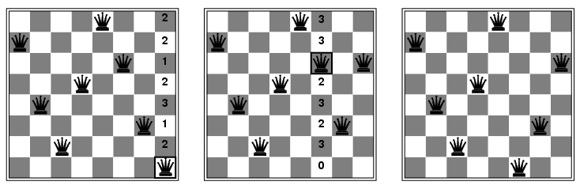
Example: 8-queens
State:
  Variables = queens, which are confined to a column
  Value = row
Start with random state
Repeat
  Choose conflicted queen randomly
  Choose value (row) with minimal conflicts

Slide 130
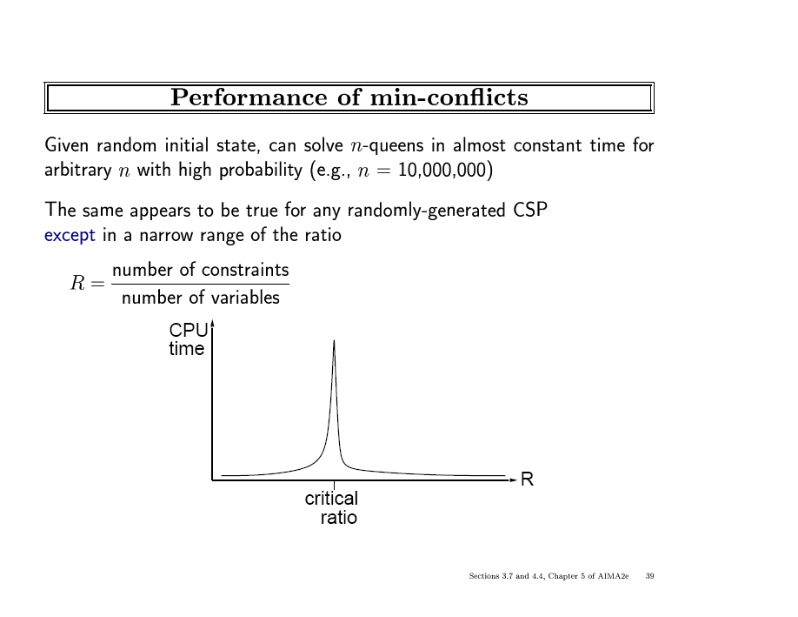

Slide 131
Summary
CSPs are a special kind of problem:
  states defined by values of a fixed set of variables
  goal test defined by constraints on variable values
Backtracking = depth-first search with one variable assigned per node
Variable ordering and value selection heuristics help significantly
Forward checking prevents assignments that guarantee later failure
Constraint propagation (e.g., arc consistency) does additional work to constrain values and detect inconsistencies
Iterative min-conflicts is usually effective in practice

Slide 132
References
Chapter 6 of “Artificial Intelligence: A modern approach” by Stuart Russell, Peter Norvig.
Chapter 5 of “Artificial Intelligence Illuminated” by Ben Coppin

